Slide 1
Plataformas de desenvolvimento
PollNow: AWS
Departamento de Engenharia Informática e de Sistemas
Mestrado em Engenharia Informática
Ricardo Rodrigues
Ruben Ferreiro
Docente: Prof. Ricardo Santos Filipe

Slide 2
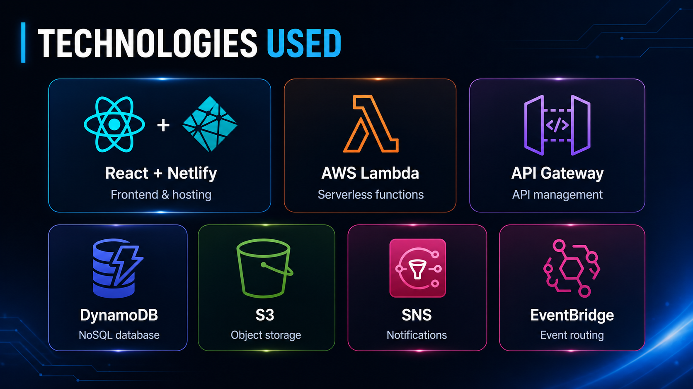
PollNow: Serverless Polling Application
PollNow
Serverless web application for creating, sharing and voting in online polls.
Notes:
Start by introducing the project as a complete serverless polling platform.
Explain that PollNow allows users to create polls, share them through links or QR Codes, collect votes and receive notifications when polls close.
Mention that the focus of the project is not only the frontend, but also the integration of several AWS services into one working cloud architecture.

Slide 3
Objective
Create a practical serverless application that allows users to:
create and manage polls;
share polls publicly;
collect anonymous votes;
display results;
receive email notifications;
automatically process expired polls.
Notes:
Explain that the goal was to build something useful but also technically relevant for an AWS project.
The project was designed to show real usage of cloud services: storage, backend logic, database, notifications and scheduling.
You can say that PollNow is simple from the user perspective but has a complete serverless structure behind it.

Slide 4
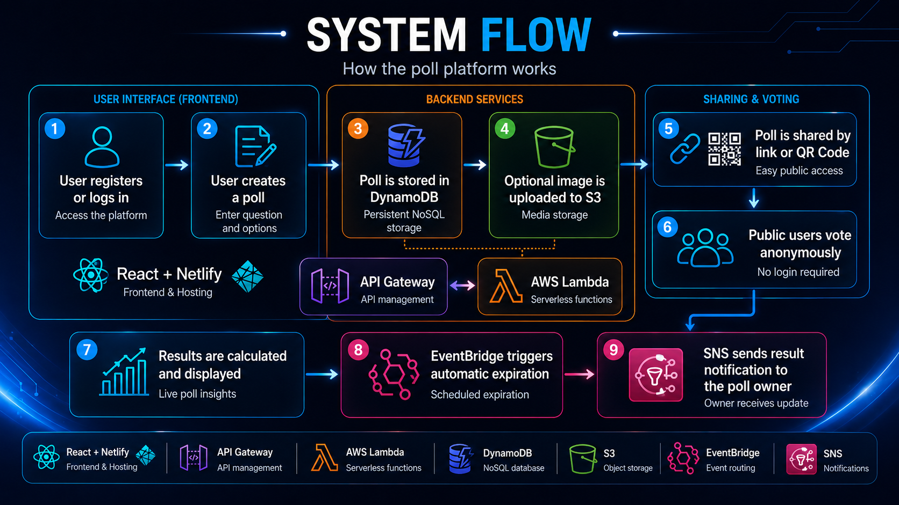
User Flow
Notes:
Walk through the flow slowly.
Use this slide to connect the user experience with the AWS services.
When the poll is created, the metadata goes to DynamoDB.
If there is an image, it goes to S3.
When people vote, votes are stored in DynamoDB.
When the poll closes, EventBridge and Lambda process it and SNS sends notifications.

Slide 5
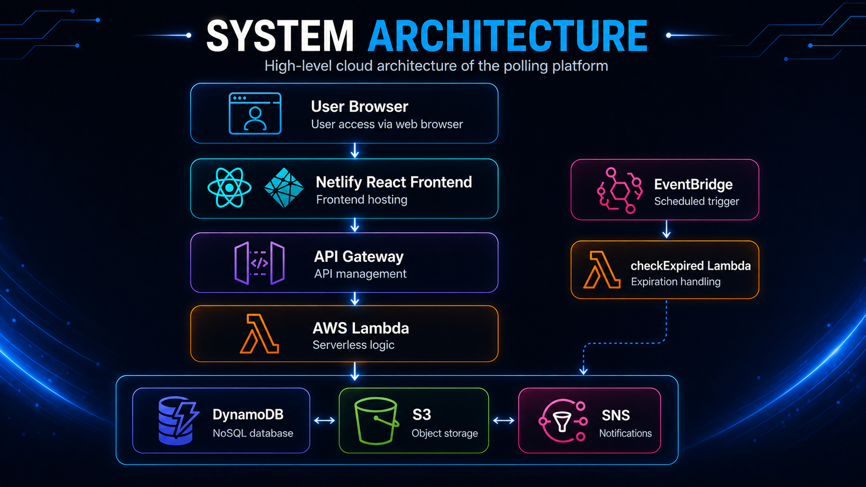
AWS Architecture
Notes:
Main idea:
Frontend and backend are separated. Backend is fully serverless.
Presenter Notes
Explain the architecture from top to bottom.
The user interacts with the React frontend hosted on Netlify.
The frontend sends HTTP requests to API Gateway.
API Gateway triggers Lambda functions.
Lambdas interact with DynamoDB, S3 and SNS.
EventBridge works separately as a scheduler. It periodically calls the checkExpired Lambda to process polls whose closing time has passed.

Slide 6
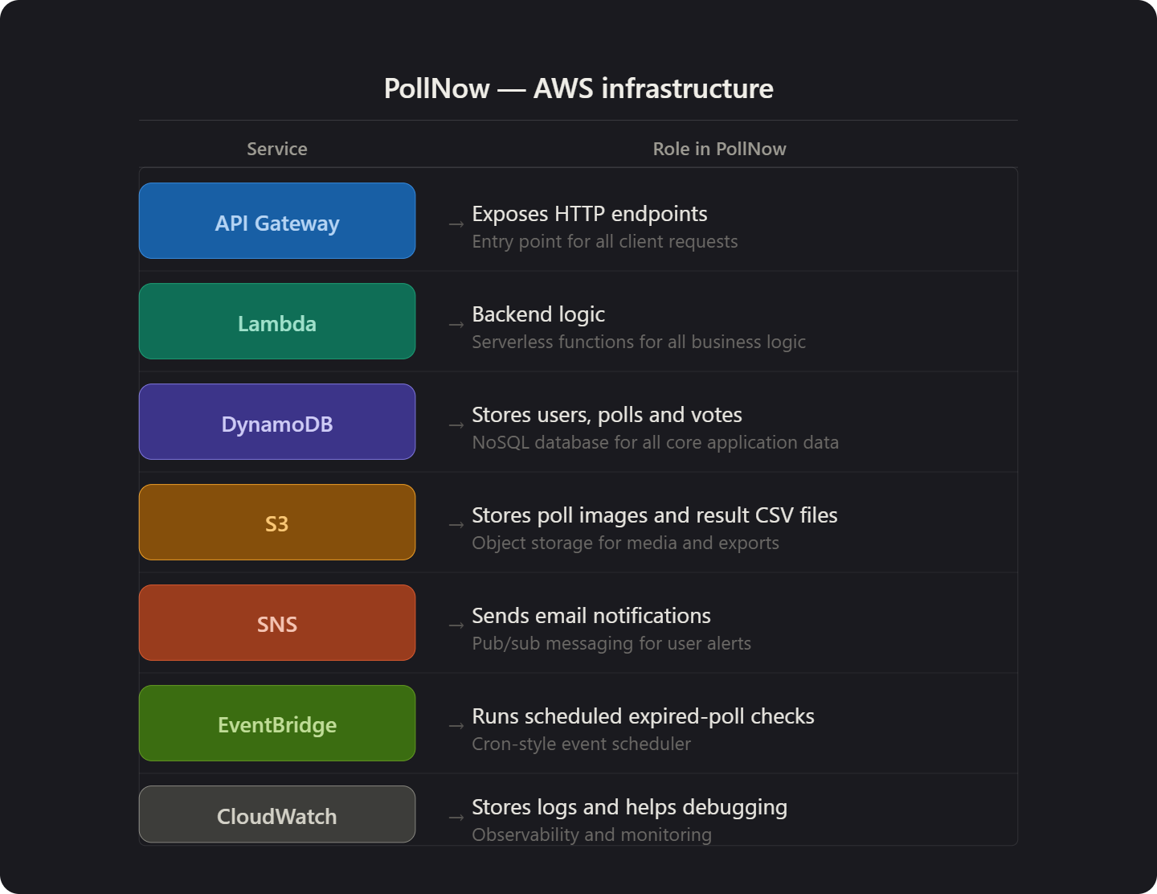
AWS Services Used
Notes:
For each AWS service, explain the practical reason it exists in the project.
Do not just list services. Show that each one has a clear purpose.
Example: S3 is not just included randomly. It stores poll images and CSV exports.
SNS sends notifications.
EventBridge automates the closure/processing flow.
This is important because the teacher will likely evaluate whether the AWS services are justified.

Slide 7
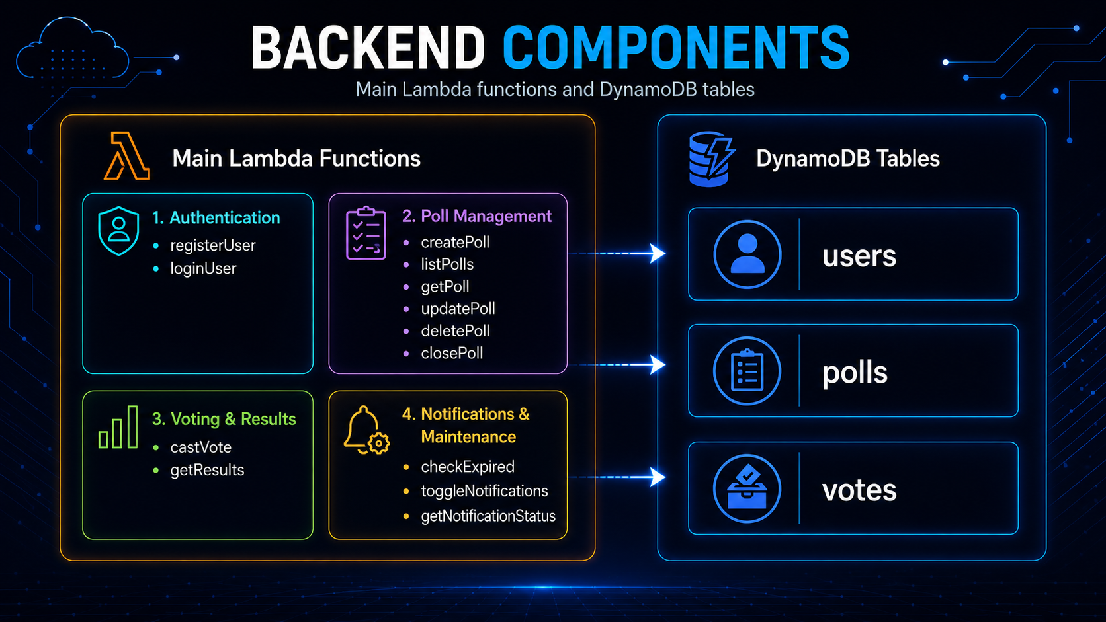
Backend and Data Structure
Notes:
Explain that the backend is divided into small Lambda functions, each with one responsibility.
This is a serverless design pattern: instead of one big server, each action has its own function.
Then explain the database:
users stores accounts and notification state.
polls stores poll metadata, owner, options, status, closing date and image URL.
votes stores anonymous votes connected to a poll.

Slide 8
Key Features Implemented
Private dashboard per user
Public anonymous voting
Vote change while poll is open
QR Code sharing
Optional poll images
Chart-based results
Manual poll close
Automatic expired poll processing
Per-owner result notifications
CSV result export to S3
Notes:
This slide is for showing project value.
Mention that the application started as a simple poll system but was improved with stronger cloud features.
The most important features to highlight are:
QR Code sharing, because it is visible and easy to demonstrate.
S3 images, because it makes polls more realistic.
EventBridge automatic processing, because it shows cloud automation.
SNS per-owner notifications, because it shows message filtering and user-specific communication.

Slide 9
Demo Plan
Open PollNow.
Log in.
Show private dashboard.
Create a poll with image.
Open share page.
Show QR Code.
Vote in the public page.
Change the vote.
Open results page.
Close the poll.
Show voting blocked after close.
Explain automatic expiration and SNS notifications.
Notes:
Use this as your demo script.
One person can present the explanation while the other controls the demo.
Keep the demo short. Do not spend too much time typing. Prepare a test account and a small image before the presentation.
If something fails live, explain the expected flow using the slide and documentation. Do not panic.
Recommended demo poll:
Title: “Class Representative Election”
Options: “Candidate A”, “Candidate B”, “Blank vote”
Image: class/school/candidate image.

Slide 10
Conclusion
PollNow demonstrates a complete serverless polling system using multiple AWS services.
The project includes:
frontend/backend separation;
serverless backend logic;
persistent data storage;
object storage;
notifications;
scheduled automation;
public and private workflows.
Notes:
Finish by summarizing the value of the project.
Say that PollNow is not just a frontend app; it is a complete cloud-based system.
Mention that the project demonstrates how different AWS services can work together to solve a practical problem.
End by saying that the system is ready for demonstration and can be extended in the future with Cognito, WebSockets, SES, CloudFront and Infrastructure as Code.

